Slide 1
Lecture 7: Design - Architecture and Methodology
based on Chapter 7

Slide 2
Objectives
Differences between Architectural and detailed design
Common architectural styles, tactics and reference architectures
Basic techniques for detailed design
Basic issues with user-interface design

Slide 3
1. Introduction
Start from requirements
How is the software going to be structured
  What are the components
  How are these components related
Two parts
  Architectural (high-level) design: A high-level overview of the system.
  Detailed design: Components are decomposed to a much finer level of detail.
Notations

Slide 4
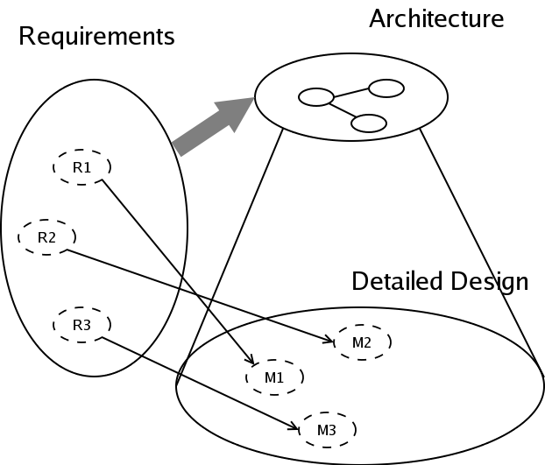
Detailed Design
come from
requirements &
architecture
Relationship between Architecture and Design

Slide 5
2. Architectural Design

Slide 6
Software Architecture
Structure(s) of system, comprising:
  Software Elements
  Their externally visible properties
  Relationships among elements
Every system has an architecture
Multiple structures
  multiple ways of organizing elements
External properties of modules

Slide 7
Background…
Architecture is the system design at the highest level
Choices about technologies, products to use, servers, etc are made at architecture level
  Not possible to design system details and then accommodate these choices
  Architecture must be created accommodating them
Is the earliest place when properties like reliability performance can be evaluated
Software Architecture

Slide 8
Architecture
Architecture is a design of the sw that gives a very high level view of parts and how they relate to form the whole
  Partitions the system into parts such that each part can be comprehended independently
  And describes relationship between parts
A complex system can be partitioned in many different ways, each providing a useful view
  Same holds true for software
  There is no unique structure; many possible
Software Architecture

Slide 9
Architecture
Definition: Software architecture is the structure or structures which comprise elements, their externally visible properties, and relationships among them
  Elements: only interested in external properties needed for relationship specification
  Details on how the properties are supported is not important for architecture
  The definition does not say anything about whether an architecture is good or not – analysis needed for that
An architecture describes the different structures of the system
Software Architecture

Slide 10
Key Uses of Architecture Descriptions
Understanding and communication
  By showing a system at a high level and hiding complexity of parts, architecture description facilitates communication
  To get a common understanding between the different stakeholders (users, clients, architect, designer, implementer, tester)
  For negotiation and agreement
  Architecture description can also aid in understanding of existing systems
Software Architecture

Slide 11
Uses…
Reuse
  A method of reuse is to compose systems from parts and reuse existing parts
  This model is facilitated by reusing components at a high level providing complete services
  To reuse existing components, architecture must be chosen such that these components fit together with other components
  Hence, decision about using existing components is made at architecture design time
Software Architecture

Slide 12
Uses..
Construction and evolution
  Some structures in architecture description will be used to guide system development
  Partitioning at architecture level can also be used to allocate work to teams as parts are relatively independent
  During sw evolution, architecture helps decide what needs to be changed to incorporate the new changes/features
  Architecture can help decide the impact of changes to existing components on other components
Software Architecture

Slide 13
Uses…
Analysis
  If properties like performance and reliability can be determined from design, alternatives can be considered during design to reach the desired performance levels
  Sw architecture opens such possibilities for software (other engineering disciplines usually can do this)
  E.g. reliability and performance of a system can be predicted from its architecture, if estimates for parameters like load is provided
  Will require precise description of architecture, as well as properties of the elements in the description
Software Architecture

Slide 14
Views and Viewpoints
View – Representation of a system structure
4+1 views
  Logical (OO decomposition) view
  Process (run-time components) view
  Subsystem decomposition view
  Physical architecture view
  +1: use cases
Other classification (Bass, Clements, Kazman)
  Module view
  Run-Time view (or component and connector view)
  Allocation view
Different views for different people

Slide 15
Background…
Architecture is the system design at the highest level
Choices about technologies, products to use, servers, etc are made at architecture level
  Not possible to design system details and then accommodate these choices
  Architecture must be created accommodating them
Is the earliest place when properties like reliability performance can be evaluated
Software Architecture

Slide 16
Views…
Many types of views have been proposed
Most belong to one of these three types
  Module
  Component and Connector
  Allocation
The different views are not unrelated – they all represent the same system
  There are relationships between elements of different views; the relationships may be complex
Software Architecture

Slide 17
Views…
Module view
  A system is a collection of code units i.e. they do not represent runtime entities
  I.e. elements are modules, e.g. class, package, function, procedure, method,…
  Relationship between them is code based
    Depends on how code of a module interacts with another module
    Example of relationships
      “module A is part of module B”
      “module A depends on services of module B”
      “module B is a generalization of module A”
Software Architecture

Slide 18
Architectural Styles
Pipes-and-Filters
Event-Driven
Client-Server
Model-View-Controller (MVC)
Layered
Database Centric
Three tier

Slide 19
Pipe and filter
Well suited for systems that mainly do data transformations
A system using this style uses a network of transforms to achieve the desired result
Has one component type – filter
Has one connector type – pipe
A filter does some transformation and passes data to other filters through pipes
Software Architecture

Slide 20
Pipe and Filter…
A filter is independent; need not know the id of filters sending/receiving data
Filters can be asynchronous and are producers or consumers of data
A pipe is unidirectional channel which moves streams of data from one filter to another
A pipe is a 2-way connector
Filters have to perform buffering, and synchronization between filters
Software Architecture

Slide 21
Pipe and filter…
Filters should work without knowing the identify of producers/consumers
A pipe must connect the output port of one filter to input port of another
Filters may have independent thread of control
Software Architecture

Slide 22
Example
A system needed to count the frequency of different words in a file
One approach: first split the file into a sequence of words, sort them, then count the #of occurrences
The architecture of this system can naturally use the pipe and filter style
Software Architecture

Slide 23
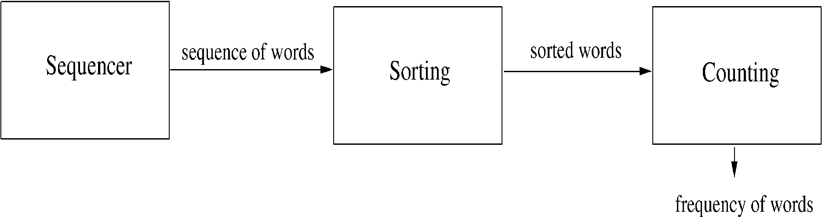
Example..
Software Architecture

Slide 24
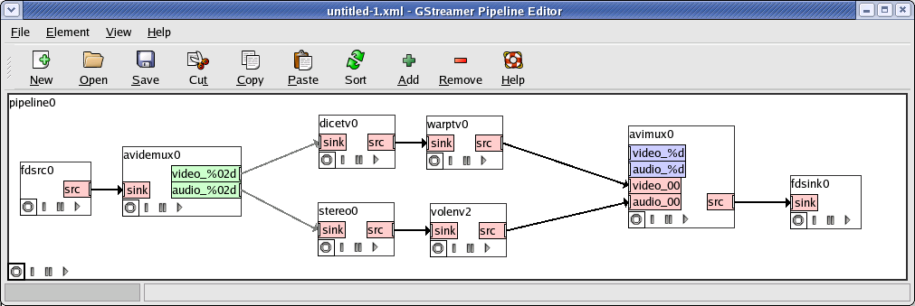
Pipes and Filters Style

Slide 25
Client-Server Style
Two component types – clients and servers
Clients can only communicate with the server, but not with other clients
Communication is initiated by a client which sends request and server responds
One connector type – request/reply, which is asymmetric
Often the client and the servers reside on different machines
Software Architecture

Slide 26
Client-server style…
A general form of this style is the n-tier structure
A 3-tier structure is commonly used by many application and web systems
  Client-tier contains the clients
  Middle-tier contains the business rules
  Database tier has the information
Software Architecture

Slide 27
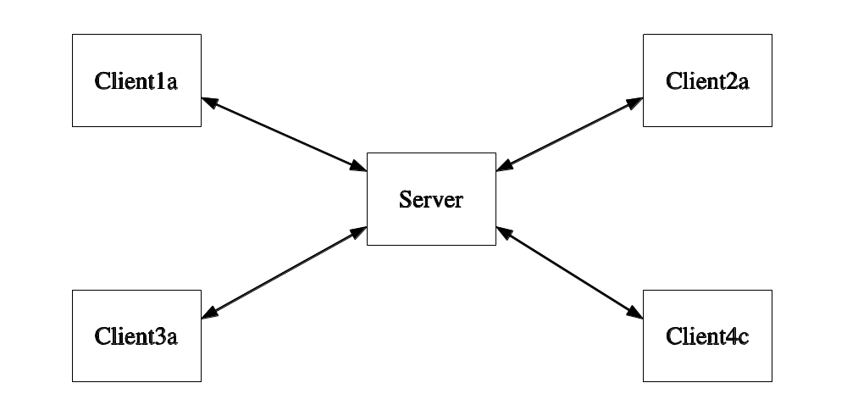
Basic Client-Server Style

Slide 28
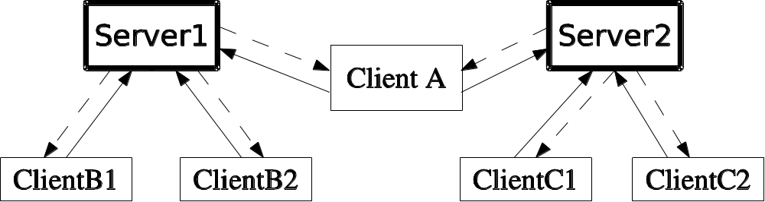
Client-Server Style
Client may connect to more than one server

Slide 29
MVC Style
Separates model (data) from view
Controller integrated with view nowadays
View 1
Controller 1
Model
View 2
Controller 2

Slide 30
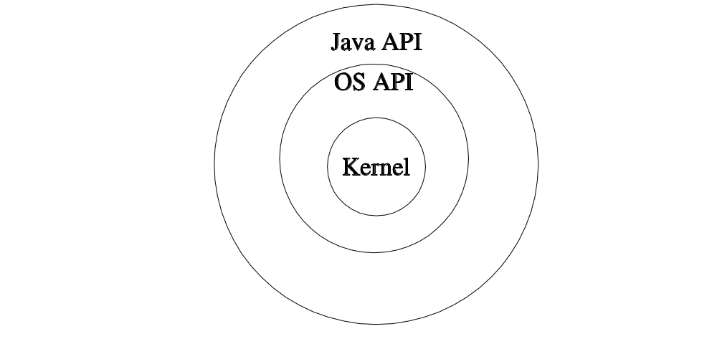
Layered Style
Figure 7.5: Layered style. The Java API implementation
calls the OS API which in turn calls kernel functions

Slide 31
Shared-data style
Two component types – data repository and data accessor
Data repository – provides reliable permanent storage
Data accessors – access data in repositories, perform computations, and may put the results back
Communication between data accessors is only through the repository
Software Architecture

Slide 32
Shared-data style…
Two variations possible
  Black board style: if data is posted in a repository, all accessors are informed; i.e. shared data source is an active agent
  Repository style: passive repository
Eg. database oriented systems; web systems; programming environments,..
Software Architecture

Slide 33
Example
A student registration system of a university
Repository contains all the data about students, courses, schedules,…
Accessors like administration, approvals, registration, reports which perform operations on the data
Software Architecture

Slide 34
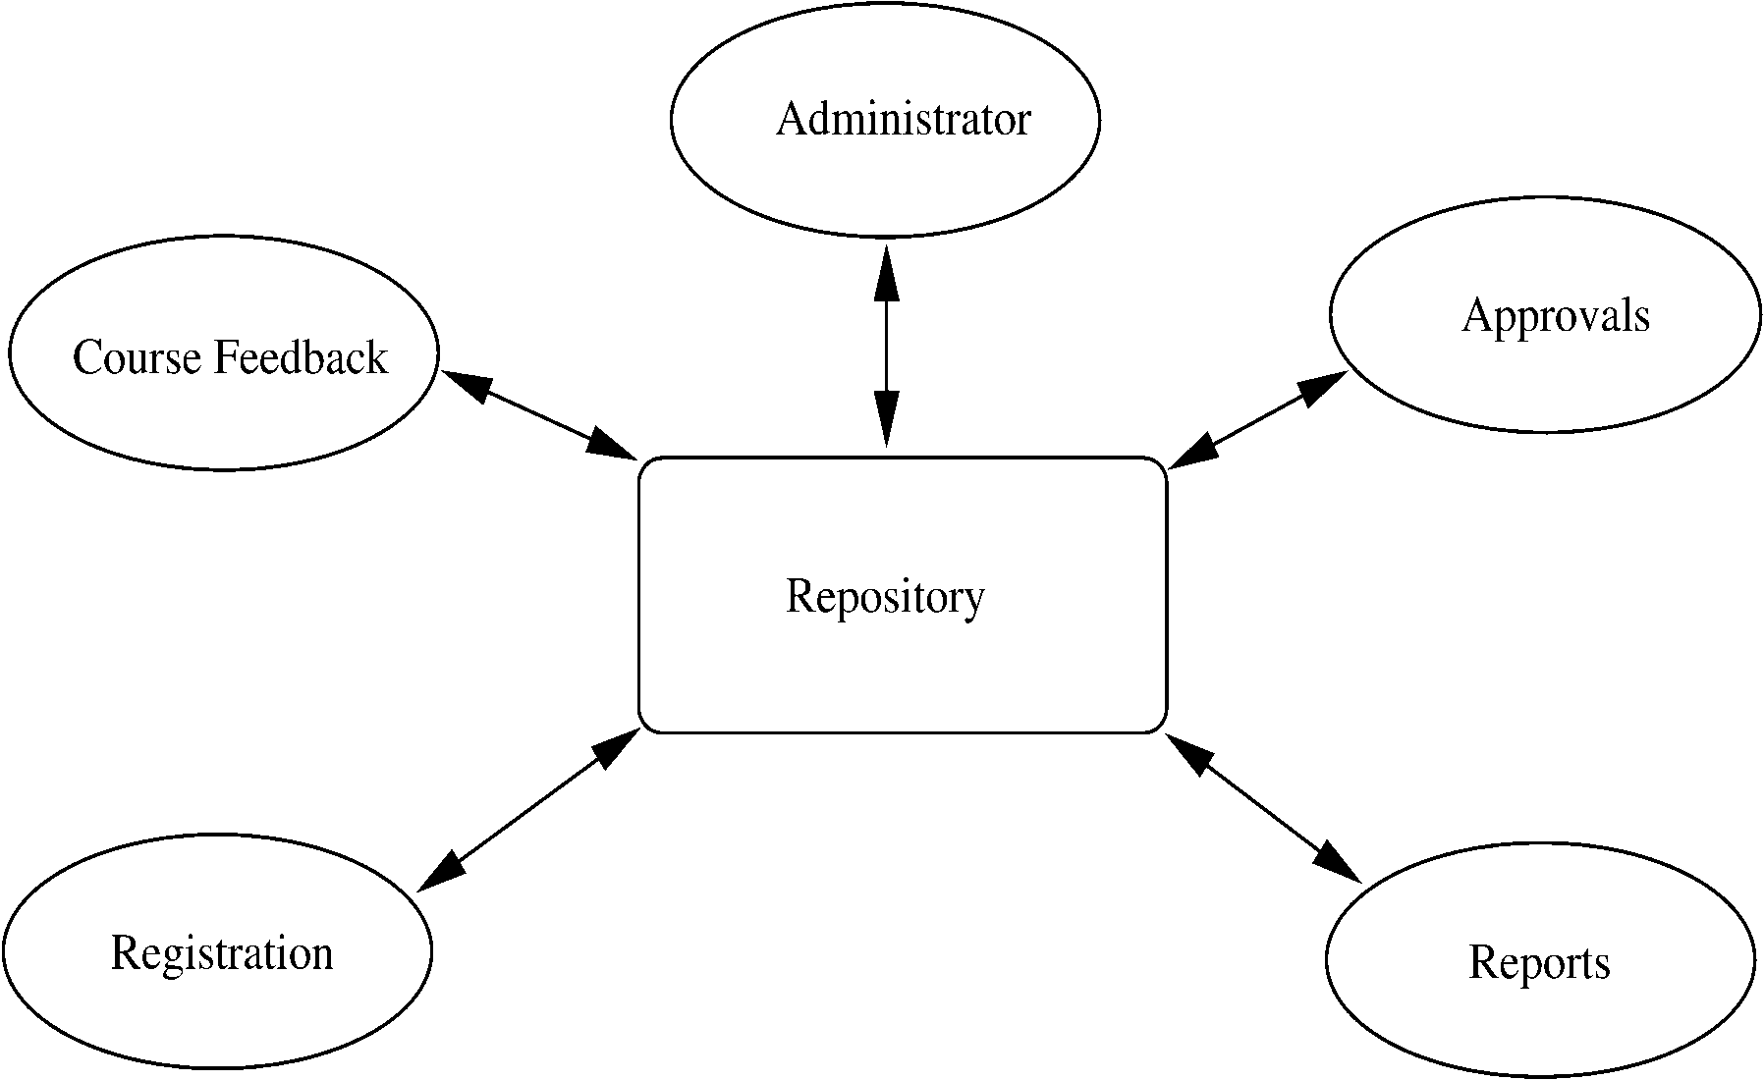
Example…
Software Architecture

Slide 35
Example..
Components do not directly communicate with each other
Easy to extend – if a scheduler is needed, it is added as a new accessor
  No existing component needs to be changed
Only one connector style in this – read/write
Software Architecture

Slide 36
Database centric style
Client1a
Client1b
DB
Client2

Slide 37
Three tier style
Clients do not access DB directly
Flexibility, integrity
Client1a
Client1b
Business
Tier
DB
Client2

Slide 38
Architectural Tactics
Solve smaller, specific problems
Do not affect overall structure of system
Example: Distributed fault detection
  Heartbeat
  Ping / echo

Slide 39
Reference Architectures
Full-fledged architectures
Templates for a class of systems
Example: J2EE Reference Architecture (MVC2)
Client1a
Business
Tier (EJB)
Web
Tier
Client1b
DB
Client2

Slide 40
3. Detailed Design
Refine Architecture and match with Requirements
How detailed ?
How formal ?
Maybe different level of detail for different views

Slide 41
Functional Decomposition
Mainly for structured programming (now Web systems)
Initially: module per task / requirement
Refine into sub-modules
There are alternative decompositions

Slide 42
Possible module decomposition
0. Main
1.Student
2.Courses
3. Sections
4. Registration
1.1 Add
2.1 Add
3.1 Add
4.1 Register
1.2 Modify
2.2 Modify
3.2 Modify
4.2 Drop
1.3 Delete
2.3 Delete
3.3 Delete

Slide 43
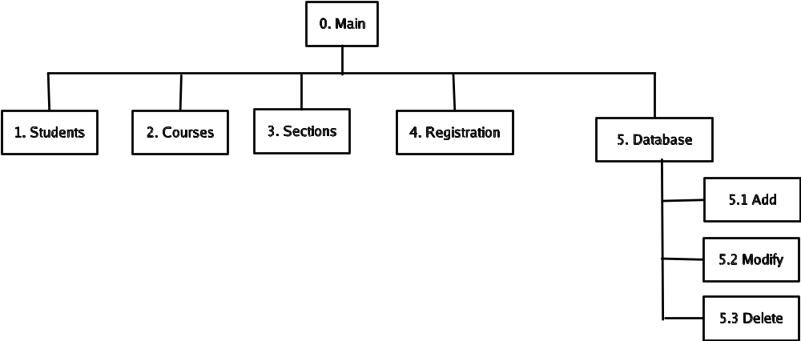
Alternative Decomposition

Slide 44
Relational Database Design
Most databases use relational technology
Relations (tables)
  Two-dimensional sets
  Rows (tuples), Columns (attributes)
  Row may be entity, relationship or attribute
  Primary key
  Foreign keys

Slide 45
Database Design
Conceptual modeling (done during analysis/requirement phase) produces ER diagram
Logical design (to relational)
Physical design (decide data types etc)
Deployment/maintenance
  Low-level physical (which hard-drive etc)
  Adjustment of indexes

Slide 46
Entity-Relationship diagrams
Entities (rectangles)
  Weak – double lines
Relationships (diamonds)
Attributes (ovals)
  Multi-valued - double lines
  Identifying - underlined

Slide 47
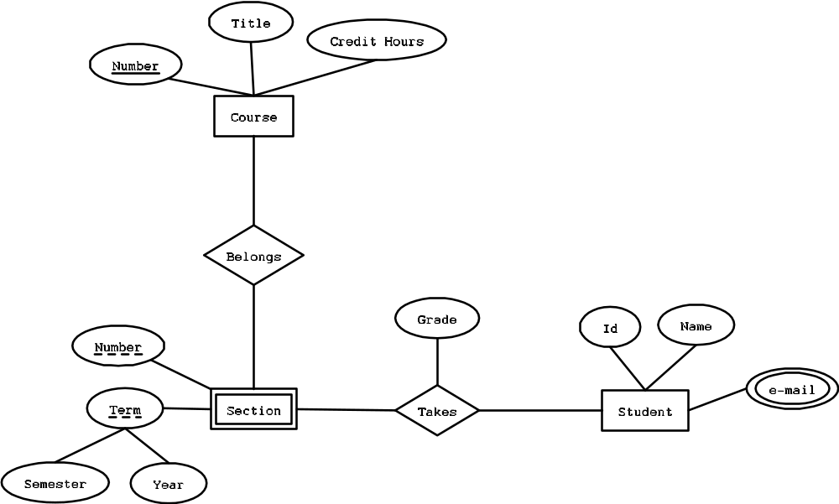
ER diagram

Slide 48
Logical DB Design- Entities
Table per entity
Flatten composite attributes
For weak entities, add the primary key of the strong entity
Course
Section
Number
CourseNumber
Title
SectionNumber
CreditHours
Semester
Year
Time
Location

Slide 49
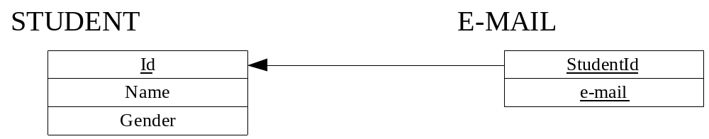
Logical DB Design – Multi-valued
New table needed for multi-valued attributes

Slide 50
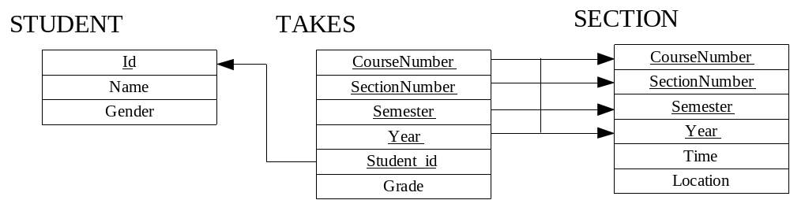
Logical DB Design - Relationships
If one side related to just one entity, add foreign key to that side
For many-to-many, need new table
For ternary, need new table

Slide 51
Physical DB Design
Data types for each attribute
  Check which ones your DBMS support
  Encoding
Decide on Indexes
  Searches are faster, updates are slower
  Indexes consume space
  Can always adjust during deployment
Denormalization done sometimes (avoid)

Slide 52
OO Design
Decide
  Which classes to create
  How are they related
UML
First step: Refine use cases

Slide 53
Use case diagram
Add Course
Register For Section
Add Section
Student
Add Student
Choose Section
Registrar

Slide 54
Class Design
Objects represent real-world entities or system concepts
Organized into classes. Objects in a class have similar characteristics
Objects have properties (attributes)
Objects also have methods
Student
dateOfBirth : Date
name : String
getAgeInYears() : int
getAgeInDays() : int

Slide 55
UML Class diagrams
Association
Composition
Is Enrolled
Student
0..*
1..1
School
Address
Student
streetName: String
streetNumber: int
city : String
state : String
zipCode : int

Slide 56
UML Class diagrams - Inheritance
Person
Student
Employee

Slide 57
UML State diagram
Accepted
enroll:
Active
Alumni
graduate:
expell:
enroll:
fails to
enroll:
Expelled
Inactive

Slide 58
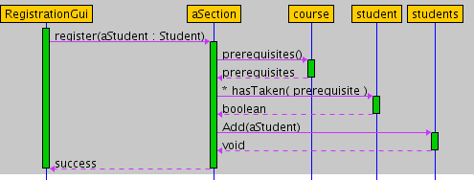
UML Sequence diagrams

Slide 59
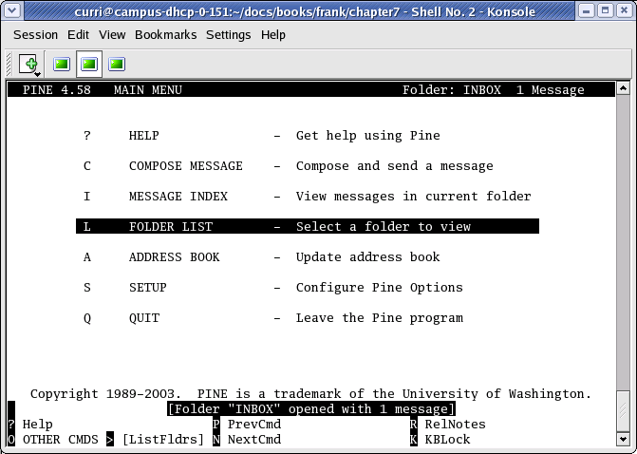
User Interface Design
Most apparent to the user
Two main issues
  Flow of interactions
  Look and feel
Types of interfaces
  Command-Line
  Text menus
  Graphical (GUI)

Slide 60
The GOMS Model
Consider different kinds of users
Four factors
  Goals
  Operations
  Methods
  Selection Rules

Slide 61
Other UI Issues
Kinds of users
Heuristics
UI Guidelines
Multicultural issues
Metaphors
Multiplatform software
Accessibility
Multimedia Interfaces

Slide 62
Object-Relational Impedance Mismatch
Relational Table
Elem 1
?
Elem 2
Encapsulated Object
Elem 3
Elem 4
Elem 5
How do we handle mismatches between object-oriented concepts and
Relational DB such as :
- typing
- private and public
- inheritance and polymorphism
- nested structure versus table structure

